Slide 1
Demo Cheat sheet
Sytorio Switchboard v1.5
Rupendra Limbore
Rupendra.Limbore@synechron.com
Synechron Inc.

Slide 2
Index
User Story– Applet List
User Story – Applet State Change Notification
Tips and Tricks

Slide 3
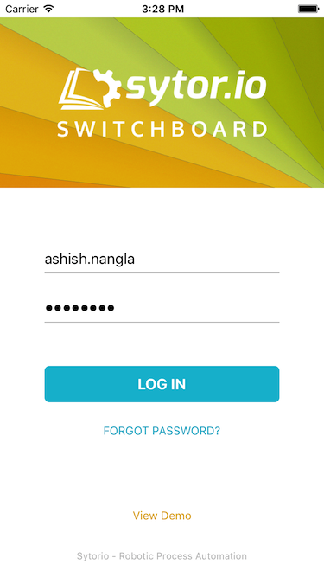
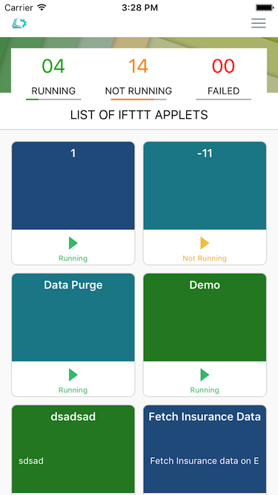
User Story – Applet List
App: Sytorio Switchboard
Steps To Demo:
Launch the app
Observe that Login screen is opened
Type user name as “ashish.nangla” and password as “welcome1”
Tap on “Log In” button
Observe that list of applets is presented.
Tap on any of the applet state types given at top.
Observe that applet list is filtered as per applet state selected.
Highlights:
Animation given to applet counts at top (running, not running and failed)
Filtering of applets on tapping on applet count.

Slide 4
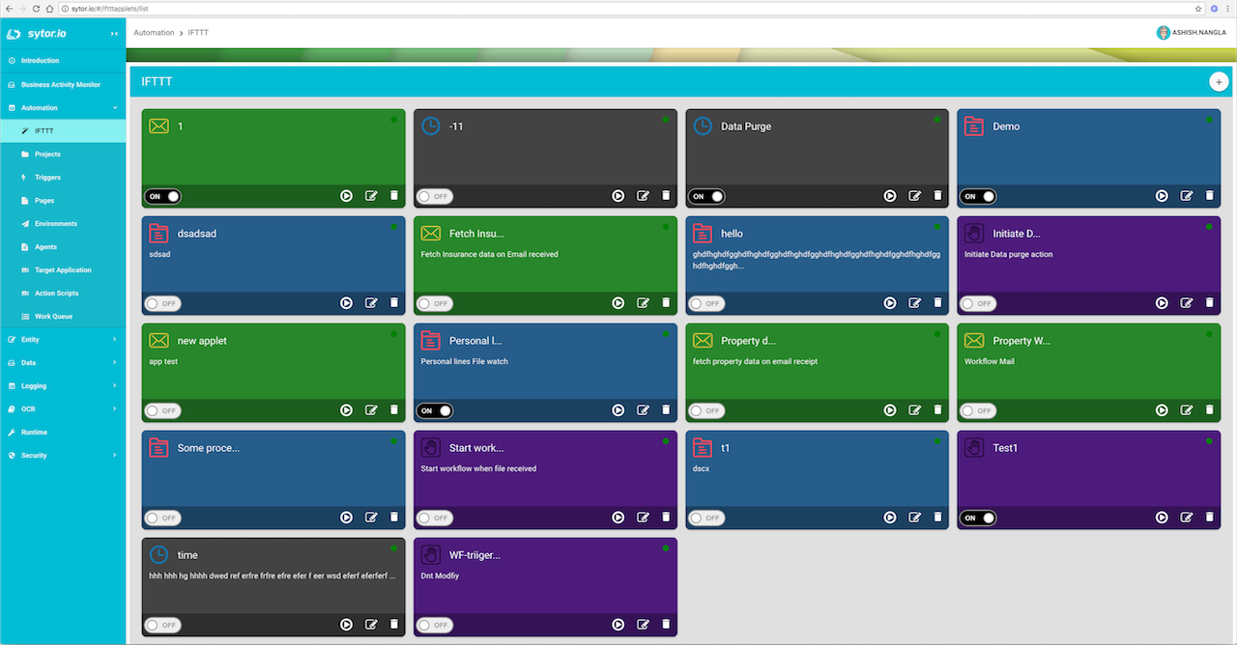
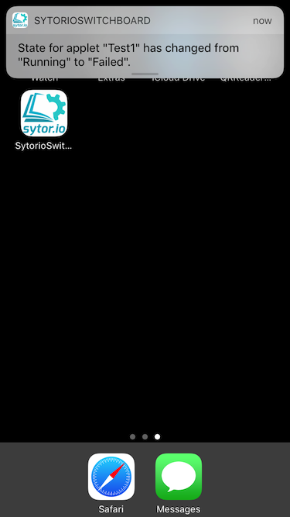
User Story – Applet State Change Notification
App: Sytorio Switchboard
Prerequisites:
Make sure that Sytorio Switchboard app has permission to show notifications. This can be checked in iOS settings app. If you are using app for the first time, the app itself will ask for permission.
Steps To Demo:
Launch the app
Observe that Login screen is opened
Type user name as “ashish.nangla” and password as “welcome1”
Tap on “Log In” button
Observe that list of applets is presented.
Tap on device Home button to minimise the application.
Launch the web app on desktop browser http://sytor.io/#/iftttapplets/list, use same credentials as iOS app.
Change the state of any of the applet, e.g. Not running to Running.
Observe that the notification (as shown in screenshot) is displayed on iOS device. (This may take 15-20 seconds as the notification currently works on pull technology and not push.
Highlights:
Notification on applet state change.

Slide 5
Tips and Tricks
If there is no internet during demo, you can tap on the “View Demo” button on login screen to give demo offline.

